Slide 1
Financial Aid Self Service
User Guide

Slide 2
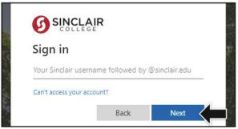
Where to Go
Log in to my.sinclair.edu

Slide 3
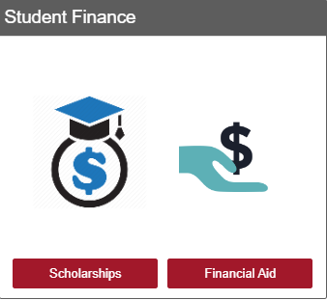
Where to Go
Enter Student finance in the search bar
Click on Student Finance
Select Student Finance
OR
Select Financial Aid

Slide 4
Where to Go
Select Award Year
Latest award year will always show first

Slide 5
Where to Go (cont.)
See FAFSA status and Account Summary

Slide 6
Where to Go (cont.)
View your Checklist
Clicking here will direct a student to www.studentaid.gov.

Slide 7
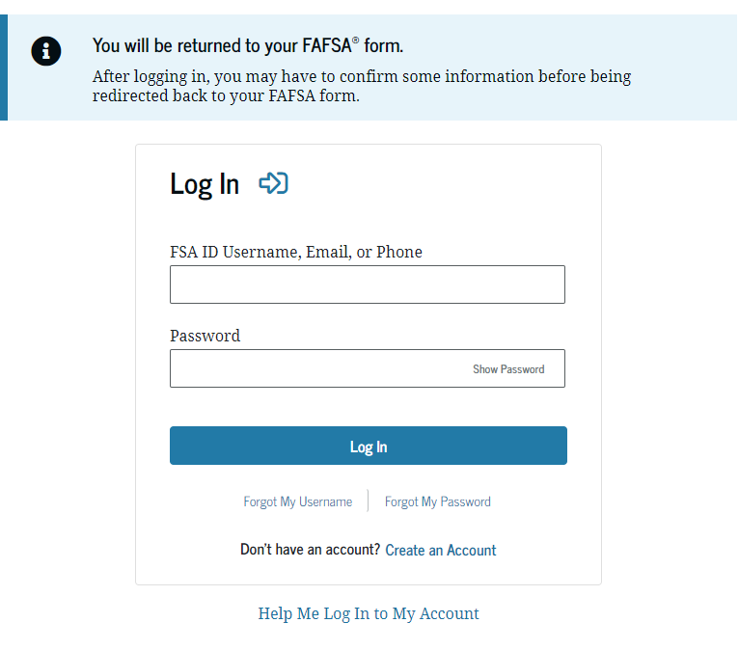
studentaid.gov website
Which FAFSA do I complete?
Attending Summer 2023?
Complete the 2022-2023 FAFSA
Attending Fall 2023 or Spring 2024?
Complete the 2023-2024 FAFSA

Slide 8
Where to Go (cont.)
Once a student completes the FAFSA, the box will update to the next checklist item. The student can click above or below.

Slide 9
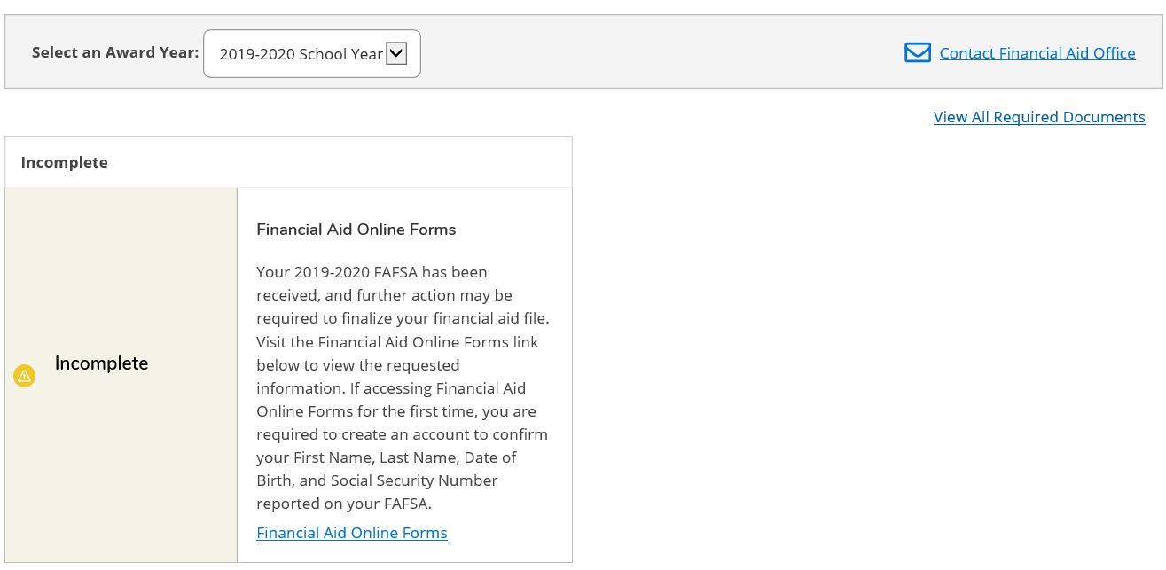
View incomplete/complete items
Students must click on the link to view required documents.

Slide 10
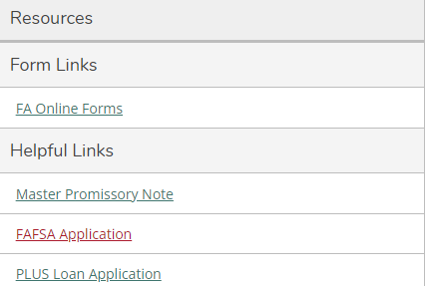
Where to Go (cont.)
Once a student submits the paperwork and the documents are received at the Financial Aid & Scholarships office to be processed, this message will appear.

Slide 11
Where to Go (cont.)
Your Financial Aid package is now ready!
This means that a student has been awarded financial aid. Students can access the information by selecting this link, or by selecting the checklist item below.

Slide 12
Where to Go (cont.)
View award details

Slide 13
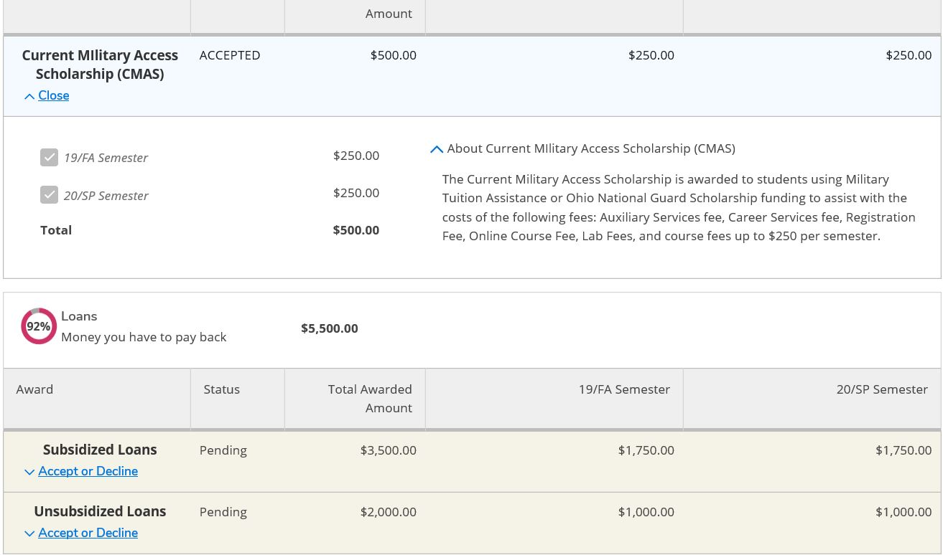
Where to Go (cont.)
Click here for more information about your financial aid awards.

Slide 14
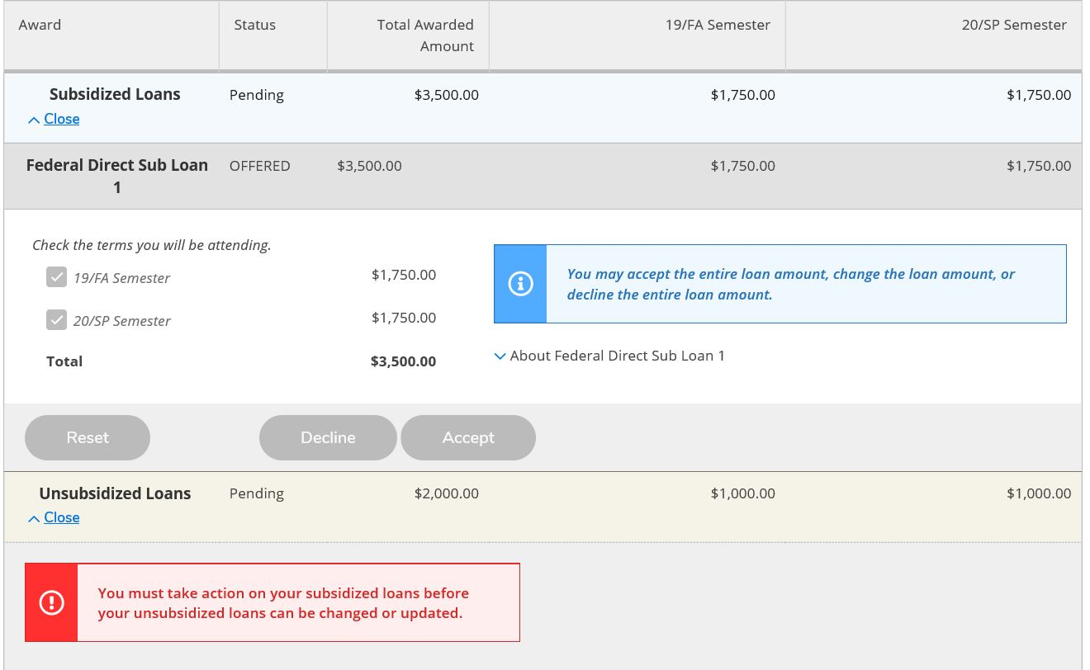
Where to Go (cont.)
This feature will allow a student to change the amount of their offered loan online rather than submitting a Change of Award form, or making the request in person or via email.

Slide 15
Where to go (cont.)
If loans are awarded, he Master Promissory Note and Entrance Counseling requirements will be added to the checklist. If these are not complete, they will show as ‘Action Needed’.

Slide 16
Where to Go (cont.)
View your Satisfactory Academic Progress (SAP) status
A GREEN Box = SAP status that is Satisfactory,
A YELLOW Box = SAP status is Financial Aid Warning A RED Box = SAP status is Suspended.
Click in this box for detail and history of the SAP status.

Slide 17
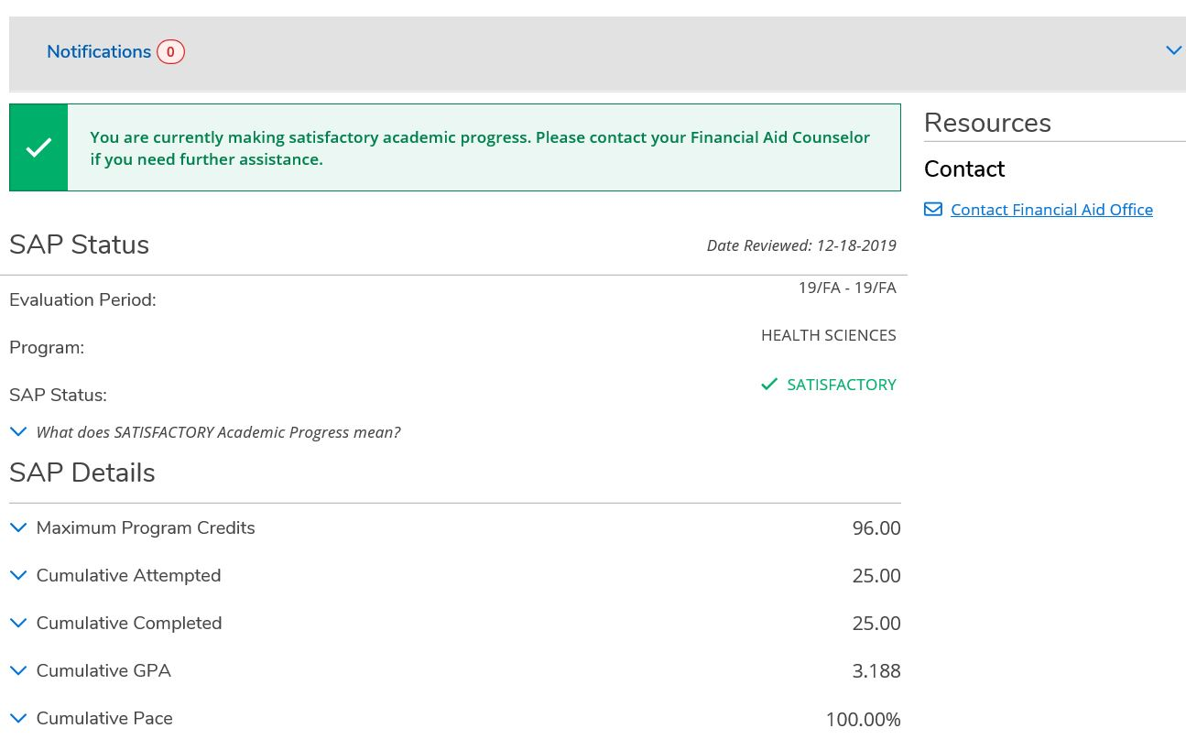
Where to Go (cont.)
A student can see when their SAP status was calculated, the term it was calculated, and the program on which it was calculated.

Slide 18
Where to Go (cont.)
Students can review their 3 most recent SAP calculations at Sinclair.

Slide 19
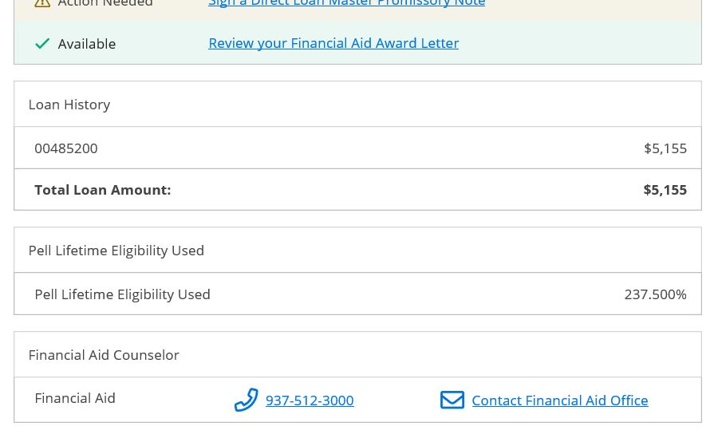
Where to Go (cont.)
A student’s current federal loan and Pell Grant history is imported real-time from the National Student Loan Database System (NSLDS). Visit (www.studentaid.gov)

Slide 20
Still have questions?
Welcome Center | 937-512-3000 finaid@sinclair.edu
Hours of Operation:
Monday – Thursday 8:00 a.m. – 5:00 p.m.
Friday 10:00 a.m. – 5:00 p.m.
www.sinclair.edu/financialaid

